Slide 1
Aspects of Metacognition in OntoAgent
Sergei Nirenburg
Institute for Language and Information Technologies
CSEE , UMBC
Joint work with:
Marjorie McShane, Stephen Beale, Tim Oates, Jesse English, Roberta Catizone, Benjamin Johnson and Bryan Wilkinson as well as Bruce Jarrell and George Fantry (University of Maryland School of Medicine)
Maryland Metacognition Seminar
May 13, 2011

Slide 2
Setting the Stage 1
The OntoAgent research program is devoted to building explanatory, knowledge-based models of artificial intelligent agents that simulate both the results and the methods of human functioning in the world.
Our team is interested both in theory and in system building.
We want agents that we build to be capable of being members of human-bot teams and carry out tasks that at the moment must be performed by people.
We are interested in simulating everyday human capabilities, not exceeding human performance in select tasks (number crunching,
even chess).
We stress deep natural language processing as a core capability of intelligent agents.

Slide 3
Setting the Stage 2
While the processing modules of our agents use a broad variety of algorithmic approaches, a uniform knowledge representation language is used throughout the system.
We model (human) memory management, learning, decision
making, agents’ personality profiles, their physical and mental
(emotional) states, preferences and prejudices, general and
specialist knowledge, their inventories of goals and plans that
can be used to attain these goals.
Knowledge of the values of features of the above processes and static knowledge resources is used in a variety of decision
(preference, evaluation, utility, etc.) functions that model the
agents’ agenda management, initiative taking, etc.
Agents can provide explanations for their decisions.

Slide 4
Setting the Stage 3
We realize that our program of studies is very ambitious. However,
we also believe that useful novel envelope-pushing applications are feasible at this time.
As a result, we have developed a research methodology that anticipates the continuing need to adopt new theories of the various phenomena relevant to intelligent agent modeling.
Moreover, we have developed and are continuously enhancing a researcher’s toolkit that facilitates assembly of application systems, experimentation with these systems and their evaluation, and acquisition and modification of static and dynamic knowledge resources for specific system configurations.

Slide 5
Metacognition
OntoAgent agents are aware of their own knowledge, perception, reasoning and action (including learning) capabilities and methods, decision functions, goals, preferences and memory contents.
They can behave in ways that reflect this knowledge.
The capabilities such as above fall within the purview of metacognition.
(I suspect that other aspects of metacognition are also present in OntoAgent agents, though we are not consciously aware of it, just like Molière’s Monsieur Jourdain from Le Bourgeois Gentilhomme who was not aware of the fact that he spoke prose…)

Slide 6
A generic agent
In OntoAgent
(lots of detail
omitted)

Slide 7
Our current core application area is clinical medicine. In this domain for a subset of agents (e.g., those playing the role of medical patient) it is necessary to simulate a human using a “double” agent comprising a physiological model (“the body”) and a cognitive model (“the mind”).
So, we implemented cognitive-style simulation of a subset of human physiological and pathological processes.
We also added the interoception channel of perception to the agent (it can be made aware of pain, difficulty swallowing and some other signals from its body).

Slide 8
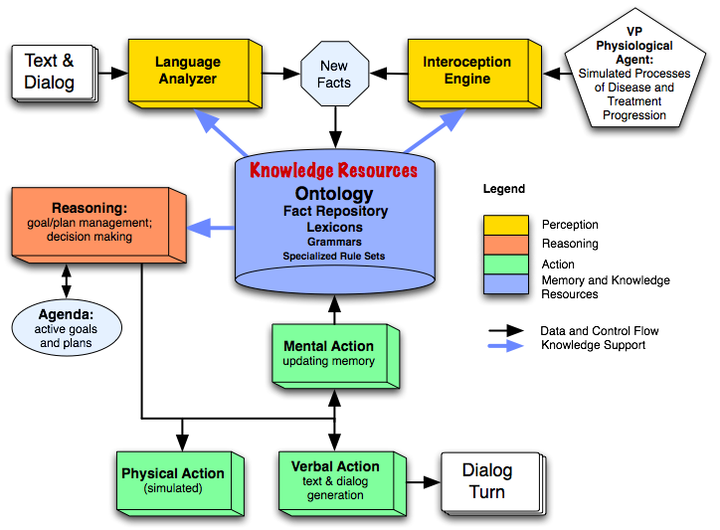

Slide 9
Different agents have different bodies. They
have different physiological traits, predispositions, etc.
react differently to diseases and medical interventions
Different agents have different minds. They :
know, remember and forget different things
have different beliefs about the same things
have different language and reasoning capabilities
have different personality traits, preferences, etc.
make different decisions
have their own models of other agents’ minds and bodies

Slide 10
To date, we have developed and integrated two proof-of-concept systems:
The Maryland Virtual Patient (MVP) for medical training; and
Clinician’s Advisor (CLAD), a decision-making aid for medical personnel.
We have configured three types of artificial intelligent agents:
Virtual Patients
Medical Advisors
Tutors

Slide 11
MVP: The Problem
According to medical educators, current training literature and pedagogical practice do not provide medical students with adequate training in cognitive analysis and problem solving.
During their apprenticeships, future MDs typically do not see a) patients with all the diseases that must be studied or b) a sufficient number of diverse cases of a particular disease.
There is not enough time for teachers to spend with individual students; and it is economically infeasible to hire more teachers.

Slide 12
State of the art solutions
State-of-the-art virtual patients (VPs) for cognitive skill training use branching narrative scenarios describing a medical case. The user selects a path through a prefabricated decision tree whose nodes correspond to decision points in diagnosis and treatment.
These systems do not even attempt to simulate the patient’s physiology or model its cognitive abilities.
As a result, the center of gravity in R&D shifts toward presentation issues. Good visualization solutions (sometimes using off-the-shelf
speech recognition and synthesis software) become the main avenue
of enhancing the verisimilitude of the interactive experience.

Slide 13
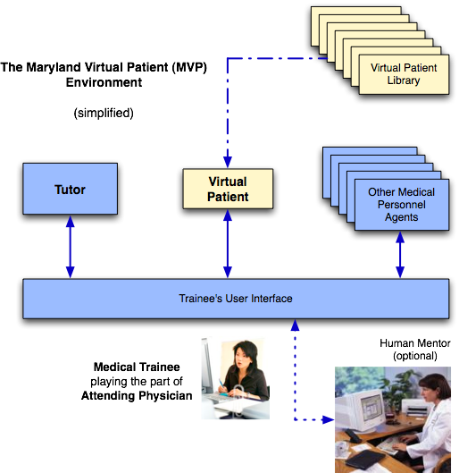

Slide 14
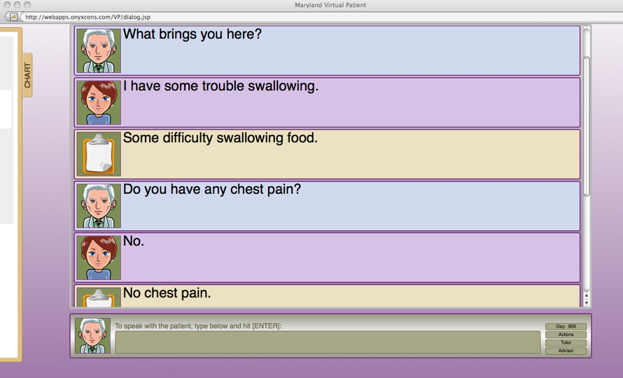

Slide 15
When the user types “What brings you here?” or a similar question, the VP:
Extracts the meaning of the user’s dialog turn, including its illocutionary force (speech act meaning) by considering and eliminating a large and diverse set of lexical, syntactic, referential and pragmatic/discourse ambiguities.
Adds the resulting text meaning representation (TMR) to the short-term memory component of its fact repository (after resolving references)
Generates an instance of a “Be-a-Cooperative-Conversationalist” goal
Prioritizes goal instances on its active goal agenda
Selects a goal instance for processing (suppose above subgoal is chosen)
Selects a plan to pursue to attain this goal (there is just one plan for this type of goal: “carry out a relevant verbal action”)
Specifies content of the verbal action to be produced (recognizes that it is playing the role of patient in an instance of “MD visit” script; looks up in its fact repository either a) the value of the property “health-attribute” or b) the worst symptom recorded in its fact repository (which symptom is the worst is a function of kind of symptom and its severity)
Generates an English sentence that realizes the above content (a report on its health attribute); lexical selection is based on the value of health-attribute; syntactic structure selection is analogy-based, driven by random selection from an inventory of sentence patterns

Slide 16
Language analyzer output for
Come back to see me in 6 months
Preprocessor Output
((COME V ((TENSE PRESENT)) NIL "Come") (BACK ADV NIL NIL "back")
(TO INF NIL NIL "to")
(SEE V ((FORM INFINITIVE)) NIL "see")
(ME N ((TYPE PRO)) NIL "me")
(IN PREP NIL NIL "in")
(*MEASURED-QUANTITY* N NIL NIL "6 months")
(*PERIOD* PUNCT NIL NIL "."))
Syntax (constituent structure)
(S (VP (VBP "Come") (ADVP (RB "back"))
(S (VP (TO "to") (VP (VB "see") (NP (PRP "me"))
(PP (IN "in") (NP (NN "6 months"))))))) (PUNCT "."))
Syntax (dependency structure)
((ADVMOD 0 1) (AUX 3 2) (DOBJ 3 4) (POBJ 5 6) (PREP 3 5) (PUNCT 0 7) (XCOMP 0 3))
Basic TMR
(partial view)
(RETURN-335
((INSTANCE-OF (VALUE RETURN))
(WORD-NUM (VALUE 0))
(ROOT-WORDS (VALUE (COME)))
(FROM-SENSE (VALUE COME-V7))
(PURPOSE (VALUE CONSULT-339))))
(CONSULT-339
((INSTANCE-OF (VALUE CONSULT))
(PURPOSE-OF (VALUE RETURN-335))
(WORD-NUM (VALUE 3))
(ROOT-WORDS (VALUE (*NULL* SEE)))
(FROM-SENSE (VALUE SEE-V7))
(BENEFICIARY (VALUE HUMAN-340))))
(HUMAN-340
((INSTANCE-OF (VALUE HUMAN))
(WORD-NUM (VALUE 4))
(ROOT-WORDS (VALUE (ME)))
(FROM-SENSE (VALUE ME-N1))))
(SECOND-342
((INSTANCE-OF (VALUE SECOND))
(WORD-NUM (VALUE 6))
(FROM-SENSE (VALUE *MEASURED-QUANTITY*-N1))
(VALUE (VALUE 1.5778458E7)))))
Speech act recognition adds:
(REQUEST-ACTION-363
((INSTANCE-OF (VALUE REQUEST-ACTION))
(THEME (VALUE RETURN-335)))))

Slide 17
Lots of “eternal” issues in semantics and pragmatics must be addressed.
Here is just a single example of the various phenomena we address by building specialized “microtheories”: Dealing with paraphrases during semantic analysis of text and interpretation of speech acts
What brings you here?
REQUEST-INFO-1
THEME COME-1.PURPOSE
AGENT PHYSICIAN-1
BENEFICIARY PATIENT-1
COME-1
AGENT PATIENT-1
DESTINATION seek-specification-1
What are your symptoms?
REQUEST-INFO-1
AGENT PHYSICIAN-1
THEME SET-1
BENEFICIARY PATIENT-1
SET-1
MEMBER-TYPE SYMPTOM-1
SYMPTOM-1
EXPERIENCER PATIENT-1
What’s up? / What’s going on?
REQUEST-ACTION-1
THEME DESCRIBE-1
AGENT PHYSICIAN-1
BENEFICIARY PATIENT-1
DESCRIBE-1
AGENT PATIENT-1
THEME EVENT-1
BENEFICIARY PHYSICIAN-1
TIME find-anchor-time
EVENT-1
SALIENCY 1
Another type of paraphrases we deal with are ontological paraphrases

Slide 18
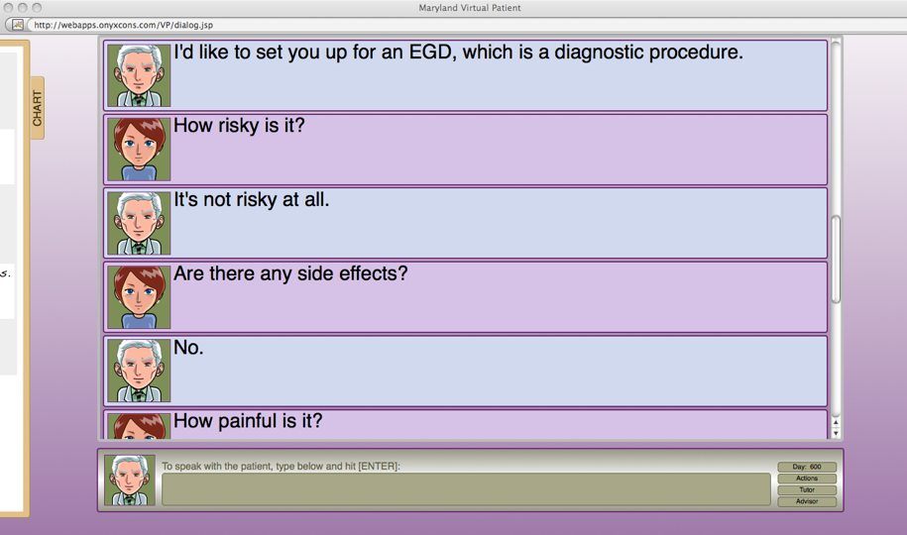

Slide 19
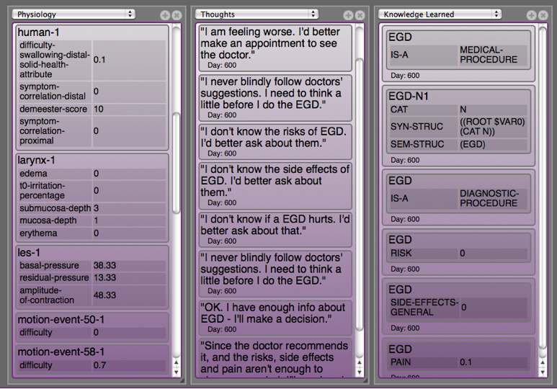
“Under the Hood” of the MVP Environment

Slide 20
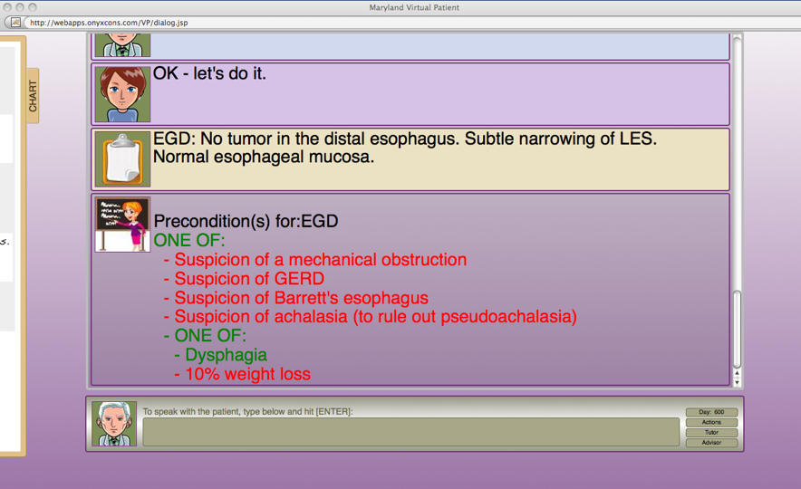
An Intervention from the Tutor

Slide 21
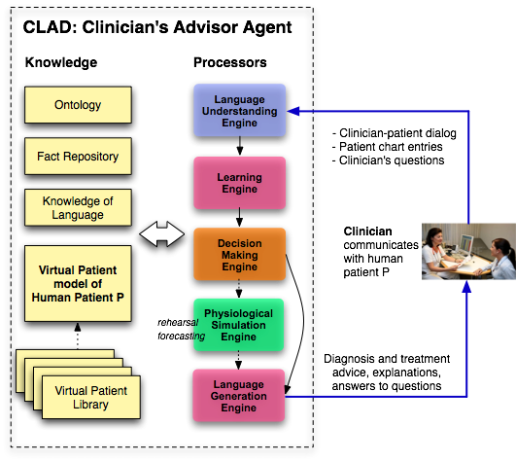
Main purpose: lowering cognitive load of clinicians

Slide 22
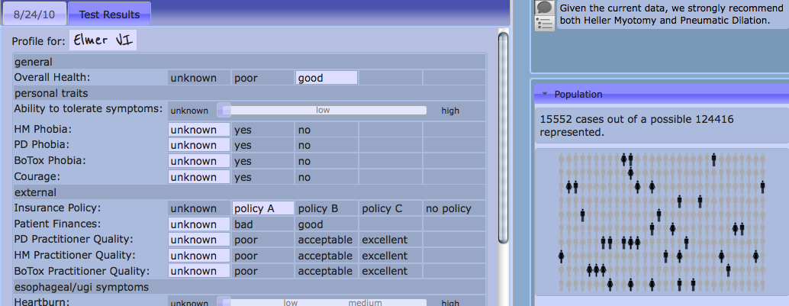
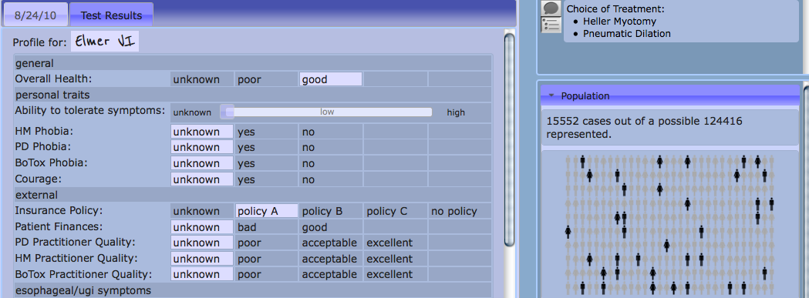

Slide 23
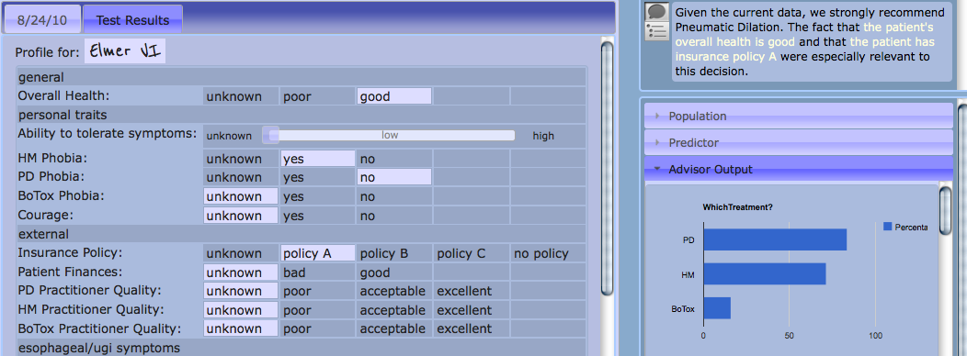

Slide 24
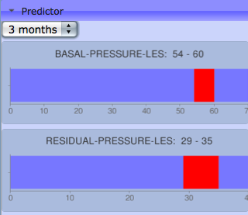
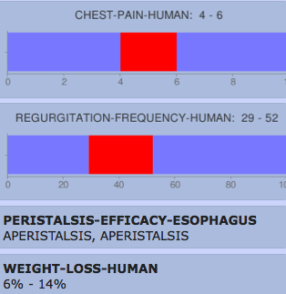
3-Month
Symptom Severity
Prognosis
CLAD’s mental simulation engine
uses the physiological simulation engine as MVP
BUT:
with incomplete knowledge
AS A RESULT:
uncertainty is encountered, leading to imprecision in predictions

Slide 25
We have implemented two approaches to decision making:
Rule based
Statistical, based on Bayesian networks created using
influence diagrams

Slide 26
This decision function was handcrafted and tweaked experimentally
BE-HEALTHY ;;a goal
(bind-variables
(*health-attribute (get-attribute health-attribute *domain 1))
(*severity (/ (round (* (- 1 *health-attribute) 100)) 100.0))
(*toleration (get-attribute ability-to-tolerate-symptoms *domain 0))
(*appointment (get-attribute appointment-time *domain -1))
(*f1 (- *severity *toleration))
(*previous-severity (get-attribute previous-severity *domain -1))
(*previous-time (get-attribute previous-see-md-time-set *domain -1)))
(if
(and
(< (+ *previous-time 100) *time*) ;;don’t run if already at MD office
(or
(and (> *appointment 0) (>= *time* *appointment))
(and (< *appointment 0) (> *f1 0)) ;; *appointment < 0 means no appointment was set
(and (< *appointment 0) (> *time-in-goal (* 6 30 60 60 24)) (> *severity 0))
(and (> *appointment 0) (<= *previous-severity 0.3) (>= *severity 0.5) (> *f1 0.1))
(and (> *appointment 0) (<= *previous-severity 0.5) (>= *severity 0.7) (> *f1 0.1))
(and (> *appointment 0) (<= *previous-severity 0.7) (>= *severity 0.9) (> *f1 0.1))))
then
see-md ;;a plan
else
do-nothing) ;;a plan
Define, retrieve or compute
values for arguments of plan preference function
Plan preference predicate
for BE-HEALTHY

Slide 27
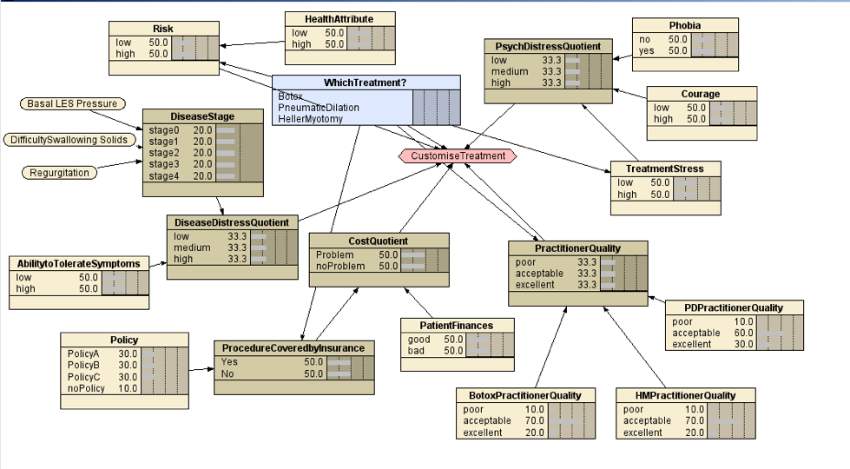
An influence diagram in the Netica environment
Formulation is “semi-automatic”: ground truth must be provided manually by subject matter experts

Slide 28
Another Window Into
OntoAgent Metacognitive Capabilities:
Integrating:
Perception
Goal and Plan Processing
Decision Making
Scheduling
Action

Slide 29
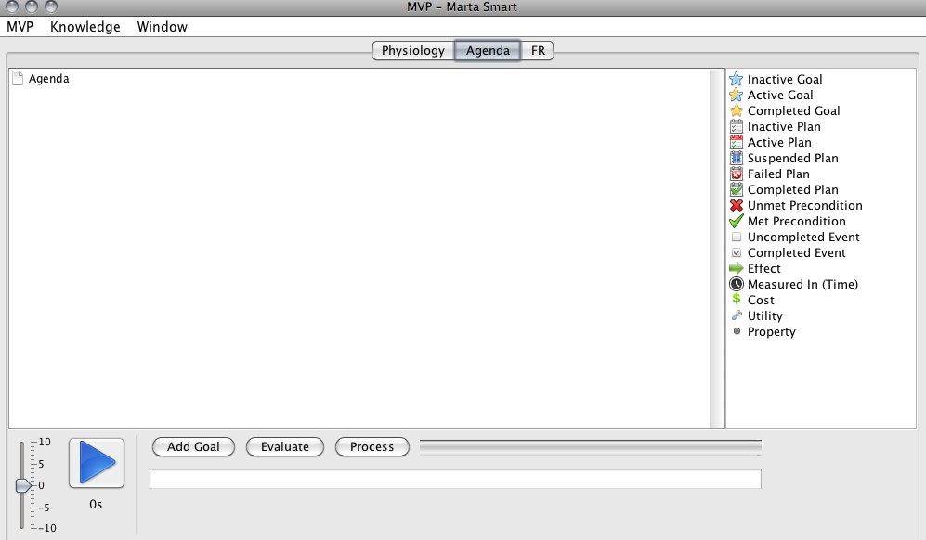

Slide 30
A. Scheduling Goals

Slide 31
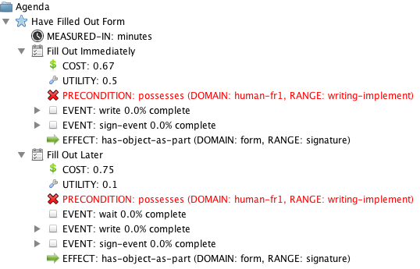
After goal “Have Fill Out Form” is added

Slide 32
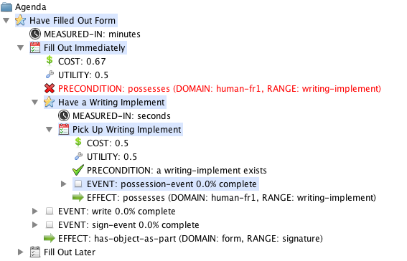
After Plan Preference Decision Function is Called

Slide 33
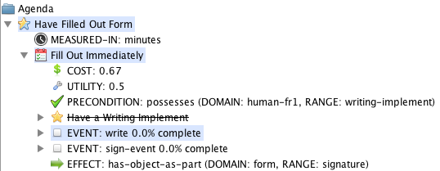
After “Pick Up Writing Implement” Plan Finishes

Slide 34
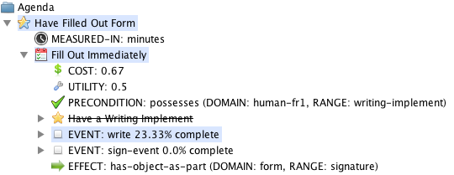
After execution of the WRITE event started:

Slide 35

While in the process of filling out the form,
the agent is asked a question:

Slide 36
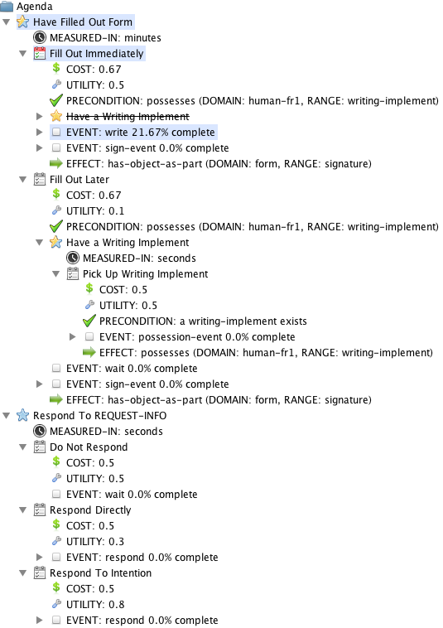
The agent processes this input, understands the meaning of the text and, as a result, puts a new goal, “Respond to REQUEST-INFO”
n its agenda:

Slide 37
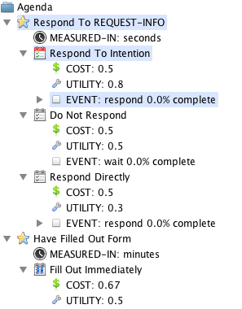
Next, it runs the goal scheduling and the plan selection functions:

Slide 38

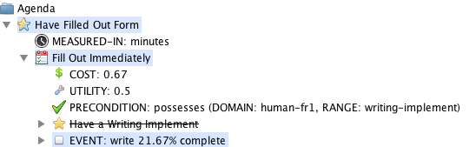
Next, the plan finishes, and a response is produced:
And the agent returns to executing the plan that was interrupted:

Slide 39
B. Choosing plans and generating verbal actions
(dialog turns)

Slide 40
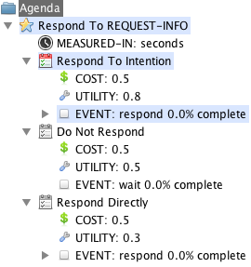
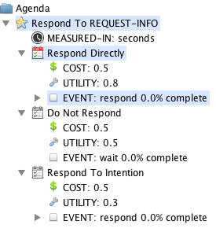
Different agents choose different plans…
“Marta Smart”:
“Marta Dumb”:

Slide 41
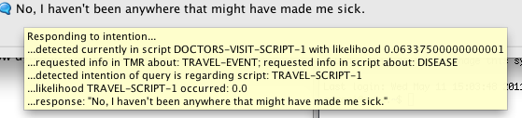

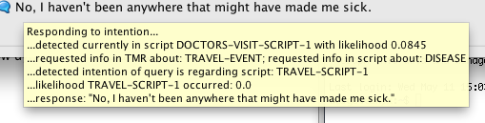
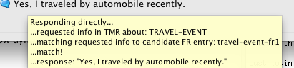
… and generate different responses:
“Marta Smart”:
“Marta Dumb”:
“Thomas Smart”:
“Thomas Dumb”:

Slide 43
References (related to the domain of clinical medicine)
Physiological Agent
McShane, M., G. Fantry, S. Beale, S. Nirenburg, B. Jarrell. 2007. Disease interaction in cognitive simulations for medical training. Proceedings of MODSIM World Conference, Medical Track, Virginia Beach, Sept. 11-13.
McShane, M., S. Nirenburg, S. Beale, B. Jarrell and G. Fantry. 2007. Knowledge-based modeling and simulation of diseases with highly differentiated clinical manifestations. 11th Conference on Artificial Intelligence in Medicine (AIME 07), Amsterdam, The Netherlands, July 7-11.
Creation of Virtual Patients
McShane, M., B. Jarrell, G. Fantry, S. Nirenburg, S. Beale and B. Johnson. 2008. Revealing the conceptual substrate of biomedical cognitive models to the wider community. In:. J. D. Westwood, R. S. Haluck, H. M. Hoffman, G. T. Mogel, R. Phillips, R. A. Robb, K. G. Vosburgh (eds.). Medicine Meets Virtual Reality 16, 281 – 286.
Cognitive Agent
Nirenburg, S., M. McShane, S. Beale. 2008. A Simulated Physiological/Cognitive "Double Agent". Proceedings of the Workshop on Naturally Inspired Cognitive Architectures, AAAI 2008 Fall Symposium, Washington, D.C., Nov. 7-9.
McShane, M., S. Nirenburg, B. Jarrell, S. Beale and G. Fantry. Maryland Virtual Patient: A Knowledge-Based, Language-Enabled Simulation and Training System. Proceedings of International Conference on Virtual Patients, Krakow, Poland, June 5-6, 2009.
Nirenburg, Sergei and Marjorie McShane. 2009. Cognitive Modeling for Clinical Medicine. Proceedings of the AAAI Fall Symposium on Virtual Healthcare Interaction. Arlington, VA.
McShane, M., S. Nirenburg, S. Beale, R. Catizone. An Overview of a Cognitive Architecture for Simulating Bodies and Minds. Proceedings of the 10th International Conference on Intelligent Virtual Agents, Philadelphia, October 2010.
McShane, M., S. Nirenburg, S. Beale, R. Catizone. A Cognitive Architecture for Simulating Bodies and Minds. Submitted to International Conference on Agents and Artificial Intelligence (ICAART 2011). Rome, Jan. 2011.
McShane, M., S. Nirenburg, S. Beale, B. Jarrell, G. Fantry. Simulated Bodies and Artificial Minds: Educational and Clinical Applications in Medicine. Submitted to Medicine Meets Virtual Reality 18, Newport Beach, CA, Feb 2011.

Slide 44
References (continued)
Language Processing (a small subset)
McShane, M., S. Nirenburg and S. Beale. 2008. Resolving Paraphrases to Support Modeling Language Perception in an Intelligent Agent. Proceedings of the Symposium on Semantics in Systems for Text Processing (STEP 2008), Venice, Italy.
McShane, M., S. Nirenburg and S. Beale. 2008. Two Kinds of Paraphrase in Modeling Embodied Cognitive Agents. Proceedings of the Workshop on Biologically Inspired Cognitive Architectures, AAAI 2008 Fall Symposium, Washington, D.C., Nov. 7-9.
Nirenburg, S and M. McShane. 2009. Dialog Modeling Within Intelligent Agent Modeling. Forthcoming. Proceedings of the Sixth Workshop on Knowledge and Reasoning in Practical Dialogue Systems at the 21st International Joint Conference on Artificial Intelligence, Pasadena, California, USA, July 11-17.
McShane. M. Reference Resolution Informing Lexical Disambiguation. To appear in Proceedings of the Fourth IEEE International Conference on Semantic Computing. Pittsburgh, PA, September 2010.
Beale, S., R. Catizone, M. McShane, S. Nirenburg. CLAD: A CLinician’s ADvisor. Submitted to AAAI Fall Symposium on Dialog with Robots, Arlington, VA, Nov. 2010.
McShane, M., English, J., Johnson, B. Flexible Interface for Annotating Reference Relations and Configuring Reference Resolution Engines. Submitted to the workshop “Computational Linguistics – Applications” of the International Multiconference on Computer Science and Information Technology, Wisla, Poland, Oct. 2010.
Reasoning
Nirenburg, S., M. McShane, S. Beale and B. Jarrell. 2008. Adaptivity in a multi-agent clinical simulation system. Proceedings of AKRR'08 - International and Interdisciplinary Conference on Adaptive Knowledge Representation and Reasoning. Porvoo, Finland, September 17-19.
Nirenburg, S., M. McShane and S. Beale. Aspects of Metacognitive Self-Awareness in Maryland Virtual Patient, Submitted to AAAI Fall Symposium on Cognitive and Metacognitive Educational Systems, Arlington, VA, Nov. 2010.

Slide 45
References (continued)
Learning
Nirenburg, S., T. Oates and J. English. 2007. Learning by Reading by Learning to Read. Proceedings of the International Conference on Semantic Computing. San Jose, CA. August.
English, J. And S. Nirenburg 2010. Striking a Balance: Human and Computer Contributions to Learning through Semantic Analysis. Proceedings of the International Conference on Semantic Computing, Pittsburgh, PA, September.
Nirenburg, S., M. McShane and S. Beale. Three Kinds of Learning in One Agent-Oriented Environment. Submitted to AAAI Fall Symposium on Biologically Inspired Cognitive Architectures, Arlington, VA, Nov. 2010.
Knowledge Substrate (a small subset)
Nirenburg, Sergei, Marjorie McShane and Stephen Beale.2009. A unified ontological-semantic substrate for physiological simulation and cognitive modeling. Proceedings of the International Conference on Biomedical Ontology, University at Buffalo, NY.
Nirenburg, S., M. McShane, S. Beale, R. Catizone. The Servant of Many Masters: A Unified Representational Knowledge Scheme for Intelligent Agents across Applications. Submitted to Knowledge Engineering and Ontology Development (KEOD), Valencia, Spain, Oct. 2010.

Slide 46
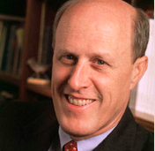
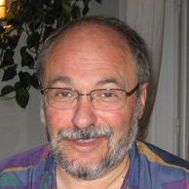
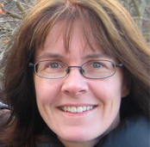

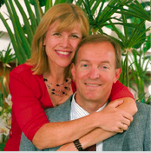
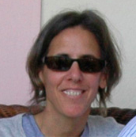
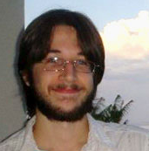

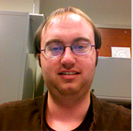
The OntoAgent Team
Bruce Jarrell
PI, Medicine
Sergei Nirenburg
Co-PI, Technology
Marge McShane
Co-PI, Knowledge
George Fantry Consultant, Medicine
Senior Researchers, Technology
Software Engineers
Steve Beale Roberta Catizone
Jesse English Ben Johnson
Bryan Wilkinson
http://trulysmartagents.org/

Slide 47
We will now present a very brief overview of the following
component technologies:
Physiological simulation,
Natural language processing and
Decision making
Learning

Slide 48
A few characteristics of physiological simulation in MVP
physiological simulation relies on symbolic
descriptions of physiological processes
the processes within the model operate over time on a
large set of anatomical and physiological parameters
defined in terms of an ontology
creating a medical case means setting and
modifying the values of a subset of the physiological
parameters in the model.

Slide 49
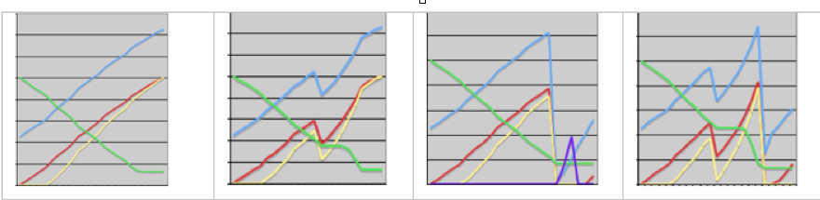
Disease progression of a given simulated patient under 4 treatment strategies: automatic variation
Left: Disease progression with no interventions.
2nd: BoTox administered in month 26.
3rd: Heller myotomy carried out in month 34.
Right: BoTox administered in month 22 and pneumatic dilation carried out in month 36.
basal lower esophageal sphincter pressure (LESP) – light blue
residual LESP – red
difficulty swallowing – yellow
amplitude of peristalsis contractions – green
heartburn – purple (only present in one of the scenarios)

Slide 50
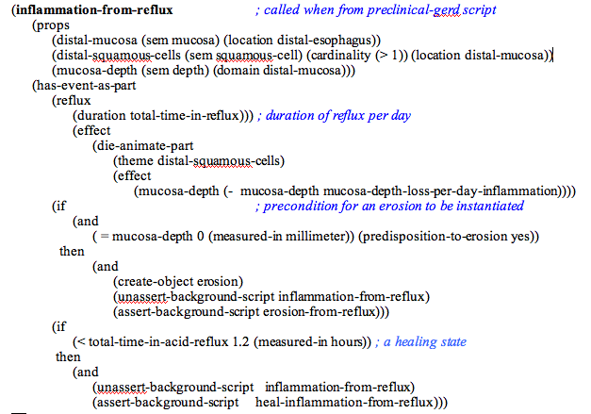
A sample simulation script (a complex ontological event)

Slide 51
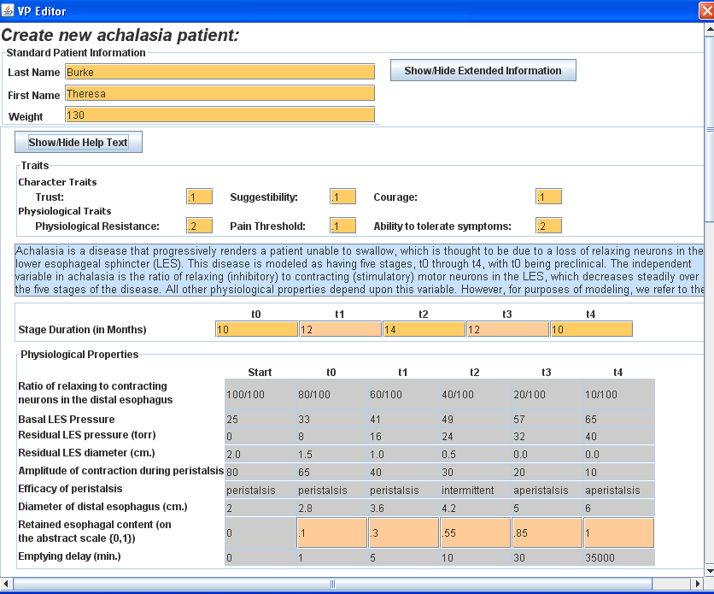

Slide 52
An excerpt from a patient authoring interface for a disease.

Slide 53
“Under the Hood”
The patient’s physiological property values and symptom profile change over time during the simulation.

Slide 54
Connecting the body and the mind: Interoception
The communication channel between the physiological and the cognitive agent is narrow: the agent is not fully aware of the activities of its “body.”
The interoception submodule operates a set of demons that are programmed a) to notice the changes in values of specific physiological parameters and b) if these values move outside a certain range, to instantiate corresponding symptoms in the VP’s fact repository.
Symptoms are represented as values of properties in the VP’s profile of self (an instance of the ontological concept HUMAN stored in the fact repository).
The appearance of certain symptoms causes the health-attribute property of the agent to decrease, which, in turn, triggers the appearance on the agent’s agenda of an instance of the goal “be-healthy.”
To reflect the situation when people do not realize that they are experiencing a symptom, a special parameter can be used to control the level of attention to physiological states.

Slide 55
The goal of perception through language is to render the meaning of language input in a format that facilitates agent reasoning. Our systems incorporate a large number of language processing modules and “microtheories.”

Slide 56
Examples of microtheories include, among many others,
treatment of aspect, time, approximations, speaker attitudes and modalities, reference, ellipsis, quantification and other phenomena.
The knowledge resources include:
- an ontology of ~10,500 concepts (~135,000 RDF triples)
- an ontological-semantic lexicon (~25,000 entries)
- fact repositories (~20,000 entries in the largest one)

Slide 58
Presemantic Processing
1. Document-level processing
Chapter and section header detection
Table detection and parsing
Detection and parsing of displayed material (e.g.,
bulleted lists)
2. Sentence boundary determination and word segmentation
3. Named entity recognition
Place names
People’s names
Organization names
4. Detection and parsing of numbers and dates
5. Detection and parsing of measured quantities
6. Mark-up stripping
7. Part of speech tagging and morphological analysis
8. Lexical look-up
Treatment of phrases
Treatment of derivational morphology
9. Syntactic processing
Phrase structure
Dependency structure
10. Syntax-to-Semantics linking

Slide 59
Basic (~ sentence-level) semantic processing / interpretation
A. Propositional content (“who did what to whom”)
Word sense disambiguation
Determination of semantic dependency
B. Speaker attitudes / Modality / Rhetorical content
C. Parameterized semantic content
Aspect
Tense
Quantification
Comparisons
Conditionals, disjunction, conjunction
Speech acts (direct)

Slide 60
Extended (~ text-level) semantic processing / interpretation
Reference resolution
Textual and extra-textual antecedents and postcedents
Bridging expressions
Grounding dialog content
Ellipsis (syntactic and especially semantic)
Treatment of unexpected input
Processing speech acts (direct and indirect)

Slide 61
OntoSem analysis results for Come back to see me in 6 months
Intermediate results:
Preprocessor
((COME V ((TENSE PRESENT)) NIL "Come") (BACK ADV NIL NIL "back")
(TO INF NIL NIL "to")
(SEE V ((FORM INFINITIVE)) NIL "see")
(ME N ((TYPE PRO)) NIL "me")
(IN PREP NIL NIL "in")
(*MEASURED-QUANTITY* N NIL NIL "6 months") (*PERIOD* PUNCT NIL NIL "."))
Syntax (constituent structure)
(S (VP (VBP "Come") (ADVP (RB "back"))
(S (VP (TO "to") (VP (VB "see") (NP (PRP "me"))
(PP (IN "in") (NP (NN "6 months"))))))) (PUNCT "."))
Syntax (dependency structure)
((ADVMOD 0 1) (AUX 3 2) (DOBJ 3 4) (POBJ 5 6) (PREP 3 5) (PUNCT 0 7) (XCOMP 0 3))
Basic TMR:
(RETURN-335
((INSTANCE-OF (VALUE RETURN))
(WORD-NUM (VALUE 0))
(ROOT-WORDS (VALUE (COME)))
(FROM-SENSE (VALUE COME-V7))
(PURPOSE (VALUE CONSULT-339))))
(CONSULT-339
((INSTANCE-OF (VALUE CONSULT))
(PURPOSE-OF (VALUE RETURN-335))
(WORD-NUM (VALUE 3))
(ROOT-WORDS (VALUE (*NULL* SEE)))
(FROM-SENSE (VALUE SEE-V7))
(BENEFICIARY (VALUE HUMAN-340))))
(HUMAN-340
((INSTANCE-OF (VALUE HUMAN))
(WORD-NUM (VALUE 4))
(ROOT-WORDS (VALUE (ME)))
(FROM-SENSE (VALUE ME-N1))))
(SECOND-342
((INSTANCE-OF (VALUE SECOND))
(WORD-NUM (VALUE 6))
(FROM-SENSE (VALUE *MEASURED-QUANTITY*-N1))
(VALUE (VALUE 1.5778458E7)))))
Speech act recognition adds:
(REQUEST-ACTION-363
((INSTANCE-OF (VALUE REQUEST-ACTION))
(THEME (VALUE RETURN-335)))))

Slide 62
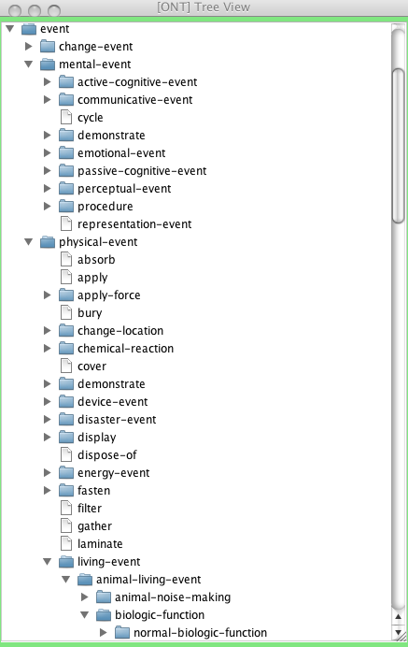
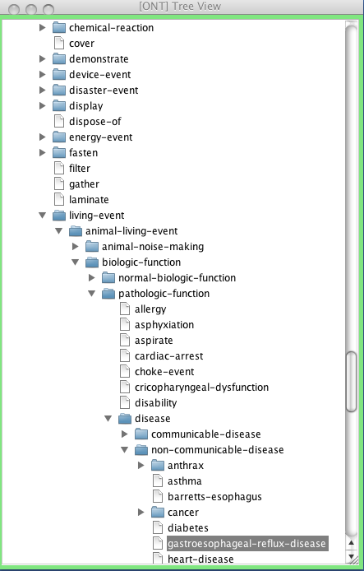
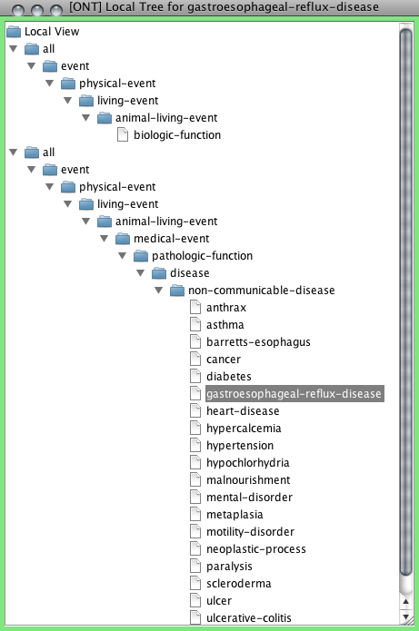
Some partial views of the ontological graph

Slide 63
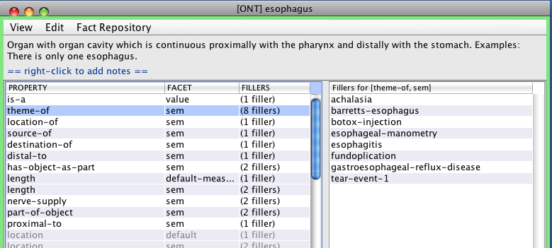
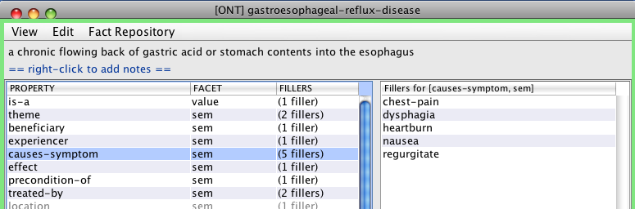
Sample ontological concepts (a partial view)

Slide 64
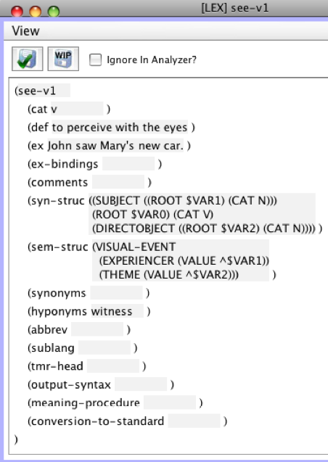
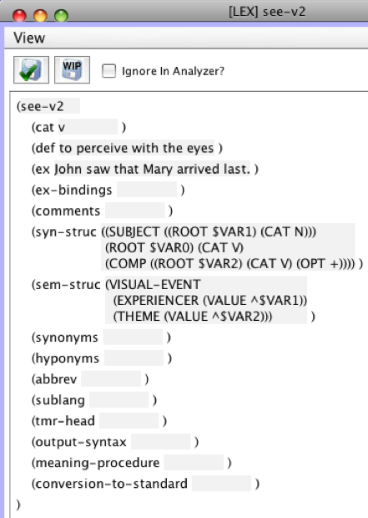
Sample lexicon entries
Disambiguated using syntactic constraints

Slide 65
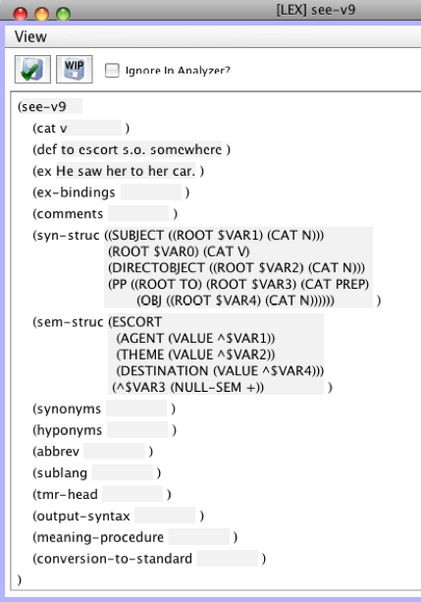
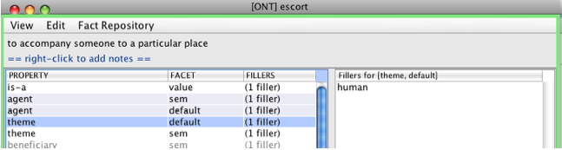
Semantic dependency information encoded in the lexicon entry
Semantic constraint stored in ontology

Slide 66
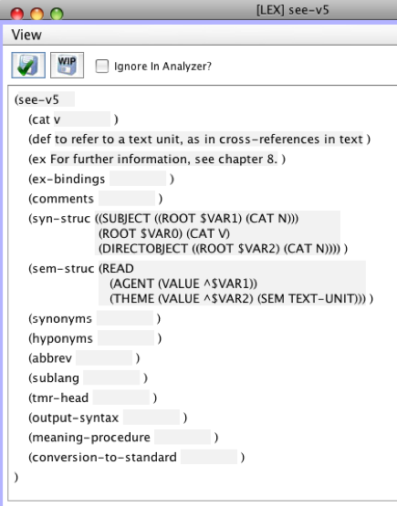
Semantic constraint stored directly in lexicon entry
The meaning of “me” in Come back to see
me in 6 months does not match the “text-unit”
constraint; therefore this sense of “come” is
not selected as a candidate for the above
sentence.

Slide 67
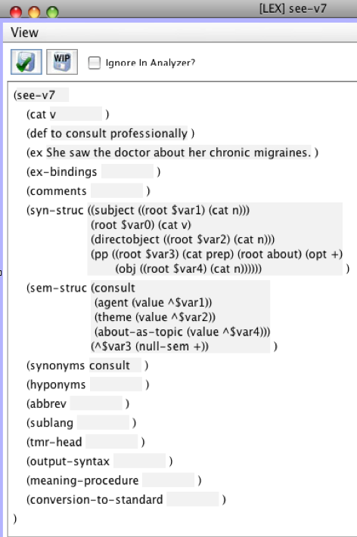
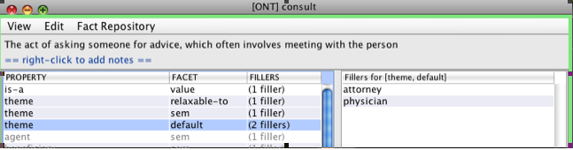
This sense of “come” is the one used in Come
back to see me in 6 months. The ontological constraint “physician” matches the meaning of “me” (that is in this case established using an element of dialog metadata: the speaker).

Slide 68
Most of the difficult issues mentioned above can be framed in terms of ambiguity resolution
Practically all the ambiguity resolution algorithms currently
used in the field:
use probabilistic statistical analysis based exclusively on
analogical reasoning that, in turn, is based on measures of
distance between words and similarity of textual contexts
are not oriented at generating meaning representations
for use by high-end reasoning systems.

Slide 69
A more inclusive approach to ambiguity resolution is to treat it using a function of a set of diverse contributing heuristics, irrespective of their provenance.
Fundamental theoretical and descriptive theory building in this area consists, therefore, in:
compiling the pool of heuristic features relevant for each
type of ambiguity resolution
for each instance of ambiguity resolution, determining the
relative importance (diagnostic strength) of each heuristic
developing methods for determining, for an input text or
dialog turn, values of the heuristics and levels of confidence
in these values
providing knowledge prerequisites for the heuristics when the cost of deriving these prerequisites is acceptable.

Slide 70
The reasoning module of the cognitive agent in MVP:
Designed to pursue attainment of goals. The inventory of goals is at
the moment limited to those relevant to the application
Goals are instantiated due to results of perception (“I feel pain”) or as
a result of agent’s own reasoning (“I don’t know enough to choose a
course of action”)
The choice of goals to pursue at a given time (some parallelism is simulated) depends on the extent and nature of the VP’s knowledge
about the world, the contents of its memory of past events and its
personality traits, beliefs about self and other agents, genetic
predispositions and physical and mental states
Different VPs have not only different personality profiles and beliefs but
also different ontologies and fact repositories
The VP is designed to reason by analogy: each goal is associated with
a set of known plans; the current version does not include dynamic
planning

Slide 71
When making decisions about its health care, the VP makes use of the following types of features:
(a) its physiological state, e.g., the intensity and frequency of symptoms
(b) certain character traits: trust, suggestibility and courage
(c) certain physiological traits: physiological-resistance (e.g., how well the VP tolerates chemotherapy), pain-threshold (how much pain the VP can tolerate) and the ability-to-tolerate-symptoms (how intense or frequent symptoms have to be before the VP feels the need to do something about them)
(d) certain properties of tests and procedures: pain, unpleasantness, risk and effectiveness. Pain and unpleasantness are, together, considered typical side effects when viewed at the population level; the VP’s personal individual experience of them is described below.
(e) two time-related properties: the follow-up-date, i.e., the time the doctor told the patient to come for a follow-up, and the current-time of the given interaction.

Slide 72
We have implemented two approaches to decision making:
Rule based
Statistical, based on Bayesian networks created using
influence diagrams

Slide 73
Learning concepts and lexical units
Learning by being told
Learning by reading
Learning by experience
Learning by reasoning

Slide 74
Learning by being told
The user may diagnose the agent with a disease about which the
VP knows nothing other that it is a disease.
The user may proceed to describe properties of the disease, in English;
alternatively, the VP may ask the user questions about various properties
of the disease (the inventory of properties will be available from an
ancestor, the DISEASE concept).
The VP will have to understand the text of the user’s dialog turn,
extract from the TMR the filler or fillers of the property or properties
in question and fill (or modify an existing filler of) an appropriate property
of the concept in question with the newly learned knowledge.
The lexicon entry for the new lexical unit referring to the disease will contain in its semantic structure zone a direct pointer to the newly learned concept (this is the simplest option available).

Slide 75
Learning by reading
In a dialog with the user the VP may be able to obtain fillers of only a subset of properties of a concept but may be interested in finding fillers
for other properties as well.
This, in the measure of the agent’s curiosity personality trait, may trigger learning by reading texts. The VP may perform a search in, say, PubMed,
retrieve relevant texts and extract from them values for some properties of interest defined in given concepts (whether newly learned or not).
Another reason for learning by reading is to acquire knowledge necessary for disambiguating a natural language input.

Slide 76
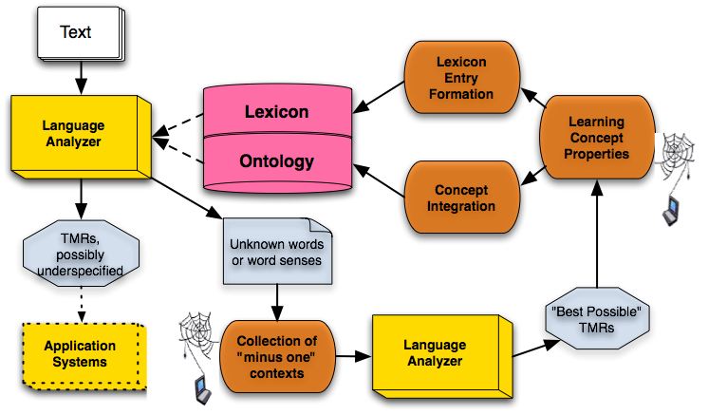
Learning by Reading

Slide 77
Future extensions: additional kinds of learning
Learning by experience: the user said that a procedure is not painful but the VP went through it and its interoceptive input tells it that the procedure is, in fact, quite painful; so the VP learns this information -- but also retains information that this user believes the procedure is not painful (which will cause a
drop in the VP’s level of trust with respect to this user).
Learning by reasoning: VP concludes that if the last EGD was not painful, the next one should not be painful either; can be overridden by experience.

Slide 80
Ongoing and Future Work: Functionalities
NLP (further develop existing functionalities for treating)
Unexpected input, fragments, indirect speech acts
Paraphrases in language, ontology and text meaning representations
Further integration of knowledge-based and statistical methods
Reference resolution
Further acquisition of complex events (scripts, plans)
Reasoning, decision making, learning
Extend inventory of features for goal and plan selection
Reasoning under uncertainty, “irrational” decision making
Develop a complete and comprehensive learning by reading application capable of extracting knowledge from electronic medical records and medical publications
Develop a goal- and plan-oriented dialog manager
Improve and extend the organization, augmentation and use of agents’ long-term and short-term memory

Slide 81
Ongoing and Future Work: Functionalities
Knowledge Acquisition
Cover additional disease groups and their diagnostics and treatment in the ontology
Continue to extend and correct the English semantic lexicon
Acquire semantic lexicons for other languages
Expand rule sets for extracting speaker intentions and other discourse-level meanings
Tools
Continue to improve knowledge acquisition and elicitation tools and system testing and evaluation tools
Continue to enhance end user interfaces

Slide 82

Enabling Technologies | VP | Tutor | CLAD | PAAD | FA
Physiological simulation: self
Physiological simulation: other agents
Mental model manipulation: self
Mental model manipulation: other agents
Interoception
Understanding Text (TMR production)
Understanding dialog (dialog act recognition)
“Listening in” on other agents’ conversations
Learning facts
Learning concepts and language: by being told
Learning concepts and language: by reading
Learning concepts and language: by experience
Learning concepts and language: by reasoning
Decision making
Metacognition (e.g., explaining one’s decisions)
Action: simulated physical
Action: mental (remembering, inferring, deciding)
Action: verbal (dialog turn generation)
PAAD: Patient’s advisor: regimen maintenance, interactive question answering, medical
information delivery, triage diagnostics, telemedecine, personalized advice
FA: Field Advisor for hospital corpsemen, flight medics and combat medics

Slide 83
Other Applications: Beyond Medical
Advisor agents for various roles in disaster prevention and relief including simulation of epidemics, natural disasters and terrorist activity (training and operational)
Agent-centered modeling of cultural differences
Diagnostic and treatment environments and tasks in
engineering, e.g., chemical engineering
Organization modeling

Slide 84
Many Opportunities for Collaboration
Perceptual apparatus in the current system bears enhancement; no speech, vision or haptic inputs at the moment
Coverage of subject domain, decision-making and natural language capabilities is never complete; work must continue on semi-automatic and automatic knowledge acquisition and elicitation
Automatic analysis of images (photo, video, X-ray, etc.) can enhance the diagnostic and treatment environments; opportunity to integrate advances in image processing
It would be wise to continue to integrate and evaluate different reasoning and decision theories
Work must continue on “eternal” problems in language processing: non-literal language, unexpected input, fragmented language, reference resolution, indirect speech acts, etc.
Human-computer interfaces must be constantly improved; opportunity to integrate latest HCI practices

